Slide 1
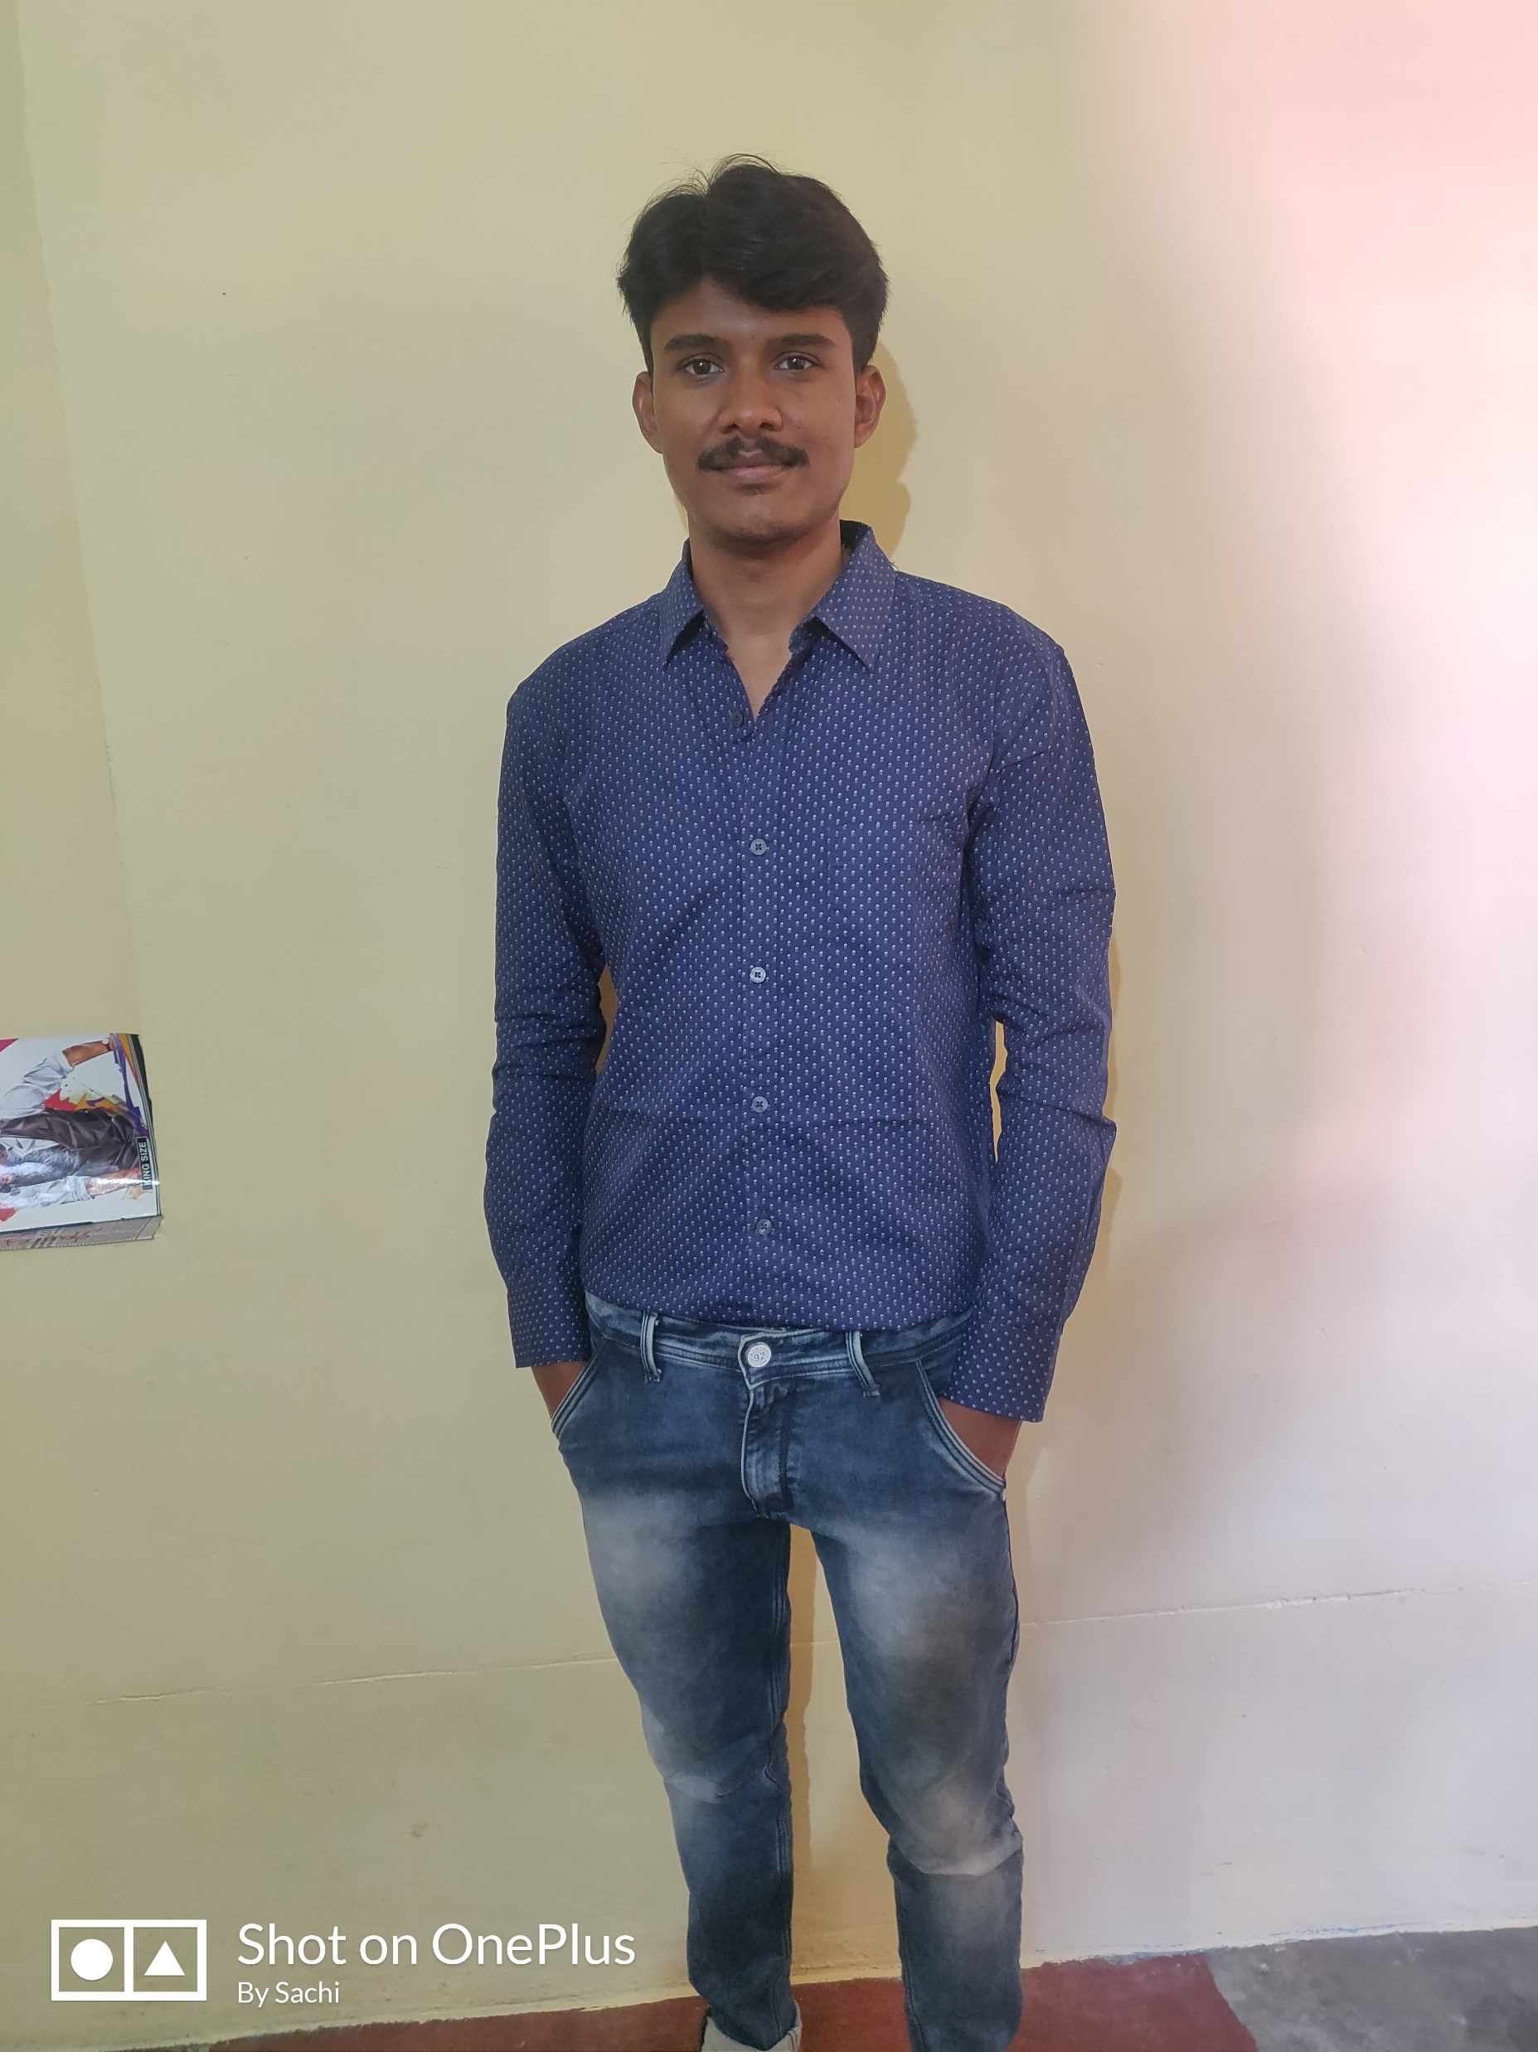


Sachin Kallur
Analyst/Software Engineer
Bachelor of Technology
Electronics & Communication Eng. :2015-2020
Skills Java 8 /J2EE
Spring Boot
Spring MVC
JPA CRUD
React
Database:
SQL database – MySQL
Additional Details:
Leadership
Quick Learner
Team management
Areas of interest and hobbies:
Playing Cricket
Listening to music
cycling
Bangalore
Sachin.kallur@capgemini.com
+91 9901584062
A4
Proficient in JAVA and OOPs concepts.
Hands on experience in creating Web Application with Spring boot , Java, Rest API, React.
Hands on experience in developing web pages using HTML5, CSS3, Object Oriented Programming, JSON, XML. Good understanding of Document Object Model (DOM) and DOM Functions.
Proficient in creating Web Application in React with Authentication with routing.
Experience in creating documentation with swagger and unit testing using JUnit.
Cab Booking Application
Completed end to end case study of Movie ticket booking application System . along with API Gateway, Swagger,Postman, responsive UI with HTML5, CSS, Bootstrap and React used as User Interface.
HTML, CSS, JAVASCRIPT for web developers at Coursera
Completed this course with 88% and Designed responsive Restaurant website using HTML5 CSS3 Bootstrap and JavaScript.

